Slide 1
How do windshield wipers work?
By Rei Shin, Yamato and Arshan

Slide 2
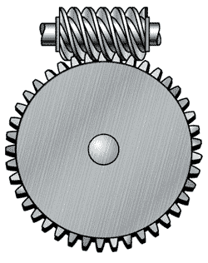
How do they work?
Windshield wipers are usually operated by an electric motor but can also be just manual. The motor is attached to a worm gear which transmits the force needed to a long rod that sets the wipers to move in such motion. The worm gear is able to generate as much force required to move wipers at whatever speed they need to be moved at. The worm gear is used around the long rod which is attached to both wipers.

Slide 3
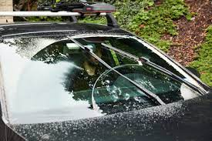
Windshield wipers have two pivot points (one on the driver’s side and one in the middle of the windshield) that work together to remove moisture. This is called the tandem system, and it provides the most coverage to clean the area of the windshield through which the driver looks out.

Slide 4
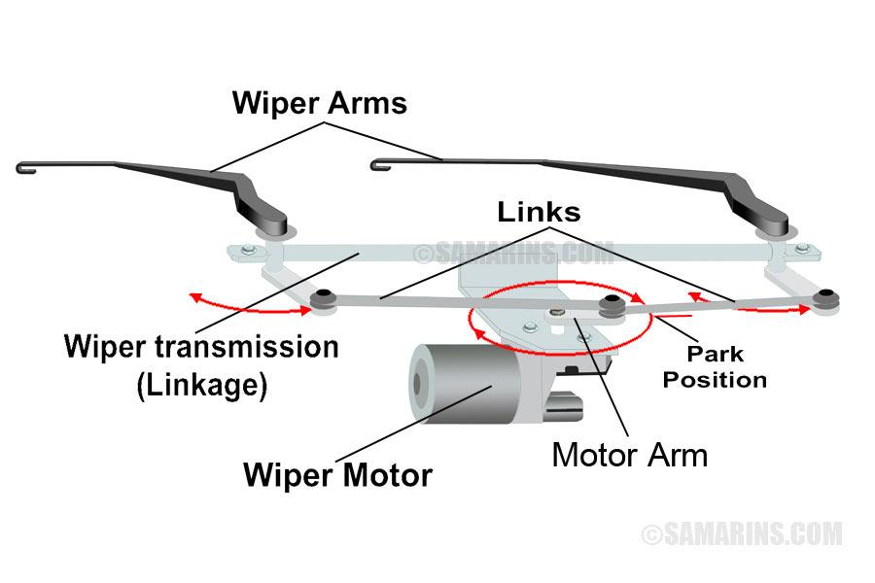

Slide 5
